Slide 1

Farming Made Easy using Machine Learning
CVR COLLEGE OF ENGINEERING
DEPARTMENT OF INFORMATION TECHNOLOGY
MINI PROJECT SEMINAR-1
Project Guide: Mrs. Swathi Agarwal(Assistant Professor)
Team Members:
Ch. Indra Nehna(19B81A12D2)
K.Manasvini(19B81A12D4)
K.Srinija(19B81A12G6)

Slide 2
ABSTARCT
India being a rural nation, its economy transcendently relies upon agricultural yield development and unified agroindustry items. It is currently quickly advancing towards a specialized turn of events. India now is rapidly progressing towards technical development. Smart farming is changing the face of agriculture in India. Agriculture is the primary mainstay of the economy in our country. In recent years because of uncertain trends in climate and other fluctuations in the price trends, the price of the crop has varied to a larger level. Farmers remain oblivious of the uncertainties, which spoils the crops and causes massive loss. They are unaware of the crop price which would benefit them more. This application designed is handy, easy-to-use which provides accurate results in predicting the price of the crop. This framework utilizes Machine Learning’s Decision Tree Regression Algorithm to predict crop price. The attributes considered for prediction are rainfall, wholesale price index, month, and year. Consequently, the system gives an advance forecast to the farmers which grows the speed of profit to them and consequently the country's economy. This system also incorporates other attributes like weather forecast, crop recommendation are also implemented.

Slide 3
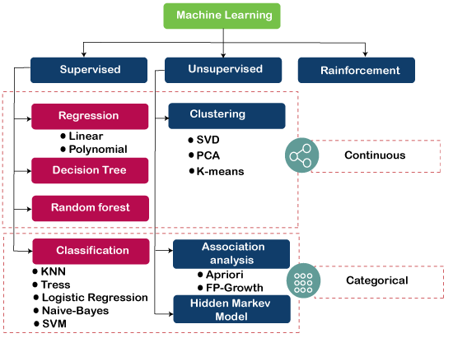
INTRODUCTION
Machine Learning is subfield of Artificial Intelligence. It has the capability of a machine to imitate intelligent human behavior.

Slide 4
LITERATURE REVIEW
Rachana, Rashmi, Shravani, Shruthi, Seema Kousar, Crop Price Forecasting System Using Supervised Machine Learning Algorithms, International Research Journal of Engineering and Technology (IRJET), Apr 2019.
In April 2019, the exploration targets foreseeing both the cost and benefit of the given harvest before planting.
The preparing datasets so acquired give enough bits of knowledge to foresee the suitable cost and request in the business sectors.
Nishiba Kabeer, Dr.Loganathan.D, Cowsalya.T, Prediction of Crop Yield Using Data Mining, International Journal of Computer Science and Network, June 2019 .
The expected utilization of data mining procedures in foreseeing the harvest yield dependent on the input parameters average rainfall and area of the field.
The easy-to-use website page created for anticipating crop yield can be utilized by any client by giving the normal precipitation and region of that place.

Slide 5
Gamage, A., & Kasthurirathna, D. Agro-Genius: Crop Prediction Using Machine Learning, International Journal of Innovative Science and Research Technology, Volume 4, Issue 10, October – 2019.
The best crop and its required fertilizers make the farmer more confident about the crop and its yield and also our system will do marketing work by estimating total value of the crop based on current market price.
The idea of the system can be extended by adding some extra features to the system like providing a nearby shop location portal for purchasing seeds and fertilizers.
Naveen Kumar P R, Manikanta K B, Venkatesh B Y, Naveen Kumar R, Amith Mali Patil, Journal of Xi'an University of Architecture & Technology, 2020.
This system is proposed to provide help to the farmers for expecting the best amount for their crops and for predicting the best price for the crops.
This also helps the farmers to check previous prices of different commodities.
The system can predict crops using [9] Random forest, Polynomial Regression and Decision Tree algorithms.

Slide 6
LIMITATION
The predictions that has been generated through this application are not 100% accurate as there would be a fluctuation in the factors like rainfall, crop quality and climatic conditions which play a major role in deciding the price of the yield and crop generated.

Slide 7
PROBLEM STATEMENT
Farmers plan for a crop based on factors like weather and climatic conditions, location of the land where it is situated. They lack proper knowledge about these factors which are essential to predict the price of a crop. Hence, looking at this problem we decided to help farmers by providing them with these factors in our application where they can easily access the data and find out the difference between the original price and predicted price of a crop. Linear Regression algorithm was used for this crop price prediction before, which resulted in less accuracy and less efficiency, as we wanted to develop a web application with more accuracy and more efficiency compared to previous one we used the KNN algorithm, Random Forest algorithm and Decision Tree algorithm.

Slide 8
MODULES AND ITS DESCRIPTION
New Farmer Signup:
Using this module farmers can signup with application.
Farmer Login:
Farmer can login to application by using username and password given at signup time and then farmer can select crop name to get its predicted prices in different market. Farmer can view all schemes details launched from the government.
Admin Login:
Admin can login to application by using ‘admin’ as username and password and then can add new schemes details.

Slide 9
MINIMUM CONFIGURATION OF HARDWARE AND SOFTWARE REQUIREMENTS
HARDWARE REQUIREMENTS:
System: i3 or Above.
Hard Disk: 40 GB.
RAM: 4 GB.
SOFTWARE REQUIREMENTS:
Python 3.7
scikit-learn
Python Flask
Windows 8 or Above Operating System
Python libraries:
NumPy
Pandas

Slide 10
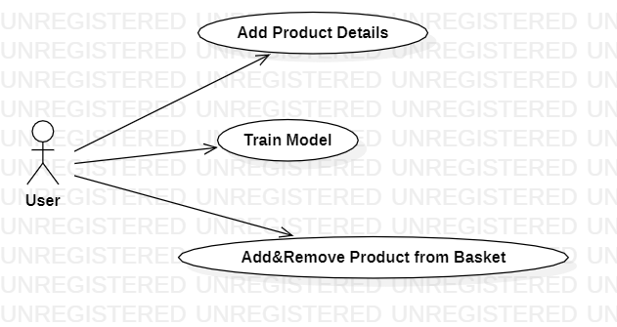
USE CASE DIAGRAM

Slide 11
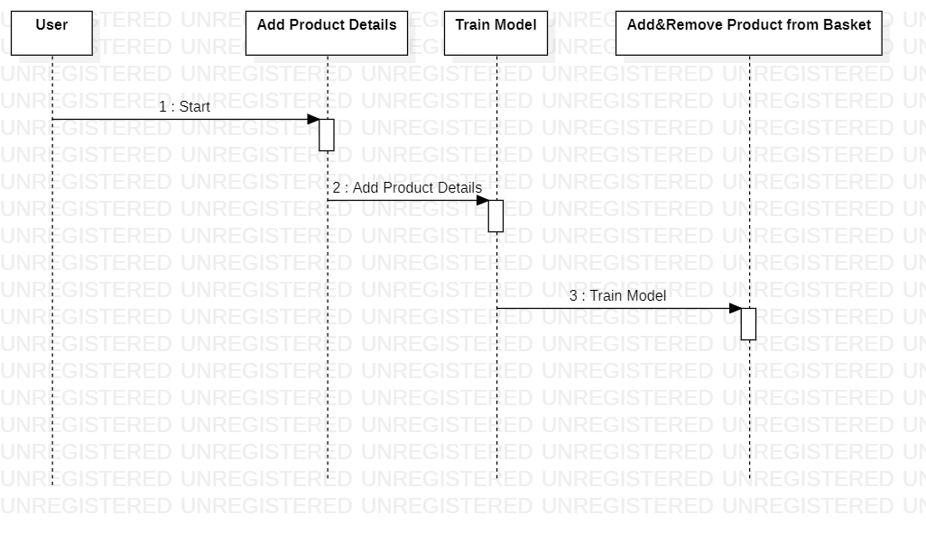
SEQUENCE DIAGRAM

Slide 12
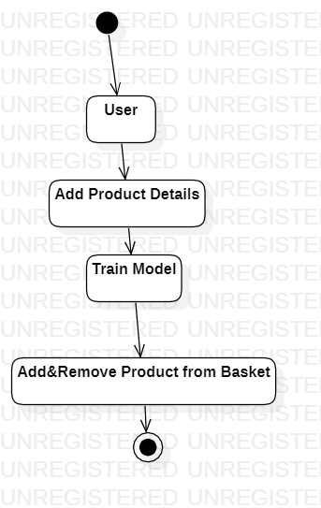
ACTIVITY DIAGRAM

Slide 13
ANALYSIS AND DESIGN
To implement the system, we decided to focus on historical data about the crop and the climate at the district level was needed to implement the system.
This data has been gathered from the government website www.data.gov.in
which includes State, District, Crop, Area and Production.
The data about the climate conditions suitable for the particular crops includes rainfall, arrival time, minimum and maximum price.

Slide 14
Exploratory Data Analysis: It refers to the critical process of performing initial investigations on data so as to discover patterns, to spot anomalies, to test hypotheses and to check assumptions with the help of summary statistics and graphical representations.
Data Cleaning: It is the process of preparing data for analysis by removing or modifying data that is incorrect, incomplete, irrelevant, duplicated, or improperly formatted.
Encoding: It is a required pre-processing step when working with categorical data for machine learning algorithms.
Feature Scaling: It is a technique to standardize the independent features present in the data in a fixed range. It is performed during the data pre-processing to handle highly varying magnitudes or values or units.
Data Partitioning: The Entire dataset is partitioned into 2 parts: for example, say, 75% of the dataset is used for training the model and 25% of the data is set aside to test the model.

Slide 15
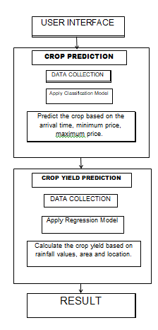
ARCHITECTURE
There are basically two categories:
Crop prediction -
It predicts the most appropriate crop based on arrival time, minimum price, maximum price.
Crop yield prediction -
It predicts the production of the crop based on area and location. The climate related data like rainfall values can be acquired through the dataset and crop type can be input through the user.

Slide 16
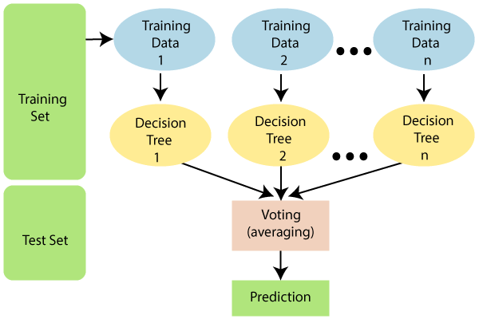
RANDOM FOREST ALGORITHM
Random forest is the supervised learning algorithm that can be used for both classification and regression problems in machine learning. It is an ensemble learning technique that provides the predictions by combining the multiple classifiers and improve the performance of the model.
It contains multiple decision trees for subsets of the given dataset, and find the average to improve the predictive accuracy of the model. A random-forest should contain 64-128 trees. The greater number of trees leads to higher accuracy of the algorithm.
To classify a new dataset or object, each tree gives the classification result and based on the majority votes, the algorithm predicts the final output.
Random forest is a fast algorithm, and can efficiently deal with the missing & incorrect data.

Slide 17
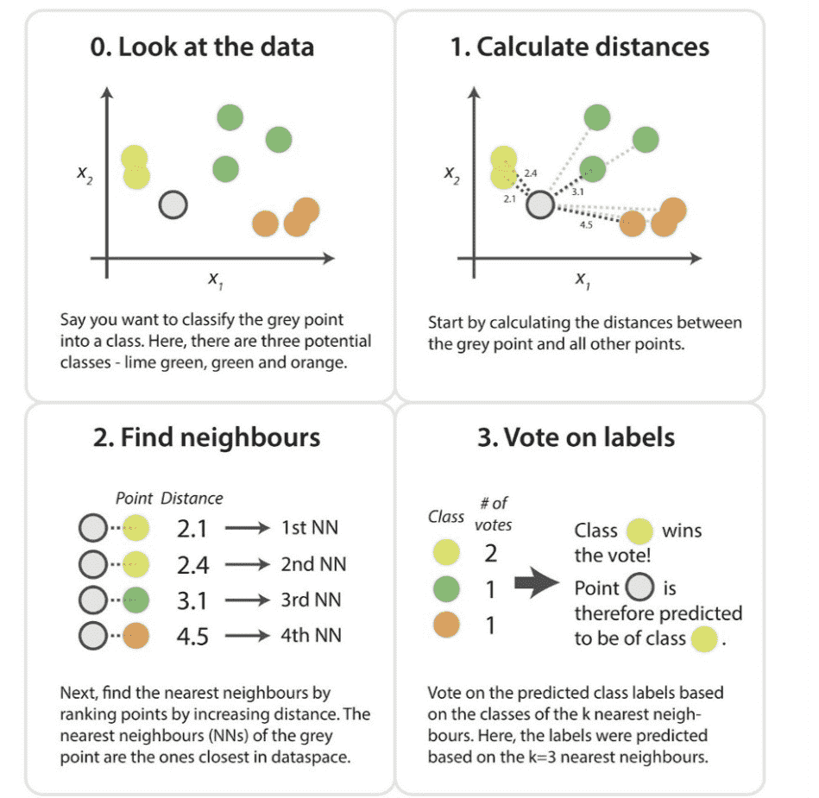
K-NEAREST NEIGHBOR ALGORTIHM(KNN)
K-Nearest Neighbor is a supervised learning algorithm that can be used for both classification and regression problems.
K-Nearest Neighbors stores all available cases and classifies new cases based on a similarity measure. It is a powerful classification algorithm used in pattern recognition.
This algorithm works by assuming the similarities between the new data point and available data points. Based on these similarities, the new data points are put in the most similar categories and any distance function measures the distance between the data points.
The distance function can be Euclidean distance based on the requirement .

Slide 18

DECISION TREE REGRESSION ALGORTIHM
A decision tree is a supervised learning algorithm that is mainly used to solve the classification problems but can also be used for solving the regression problems. It can work with both categorical variables and continuous variables. It shows a tree-like structure that includes nodes and branches, and starts with the root node that expand on further branches till the leaf node.
The internal node is used to represent the features of the dataset, branches show the decision rules, and leaf nodes represent the outcome of the problem.
Decision trees are powerful and popular tools for classification and prediction.
Decision trees represent rules, which can be understood by humans and used in knowledge system such as database.

Slide 19
REFERENCES
[1] Rachana, Rashmi, Shravani, Shruthi, Seema Kousar, Crop Price Forecasting System Using Supervised Machine Learning Algorithms, International Research Journal of Engineering and Technology (IRJET), Apr 2019
[2] Nishiba Kabeer, Dr.Loganathan.D, Cowsalya.T, Prediction of Crop Yield Using Data Mining, International Journal of Computer Science and Network, June 2019
[3] J. Vijayalakshmi, K. PandiMeena, Agriculture TalkBot Using AI, International Journal of Recent Technology and Engineering (IJRTE), July 2019
[4] Gamage, A., & Kasthurirathna, D. Agro-Genius: Crop Prediction Using Machine Learning, International Journal of Innovative Science and Research Technology, Volume 4, Issue 10, October – 2019
[5] Vohra Aman, Nitin Pandey, and S. K. Khatri. "Decision Making Support System for Prediction of Prices in Agricultural Commodity." 2019 Amity International Conference on Artificial Intelligence (AICAI). IEEE, 2019.

Slide 20
[6] Nguyen, Huy Vuong, et al. "A smart system for short-term price prediction using time series models." Computers & Electrical Engineering 76 (2019).
[7] Sangeeta, Shruthi G, Design And Implementation Of Crop Yield Prediction Model In Agriculture, International Journal Of Scientific & Technology Research Volume 8, Issue 01, January 2020.
[8] Rohith R, Vishnu R, Kishore A, Deeban Chakkarawarthi, Crop Price Prediction and Forecasting System using Supervised Machine Learning Algorithms, International Journal of Advanced Research in Computer and Communication Engineering, March 2020 .
[9] Naveen Kumar P R, Manikanta K B, Venkatesh B Y, Naveen Kumar R, Amith Mali Patil, Journal of Xi'an University of Architecture & Technology, 2020.
[10] Kumar, Y. Jeevan Nagendra, et al. "Supervised Machine learning Approach for Crop Yield Prediction in the Agriculture Sector." 2020 5th International Conference on Communication and Electronics Systems (ICCES). IEEE, 2020.

